Slide 1
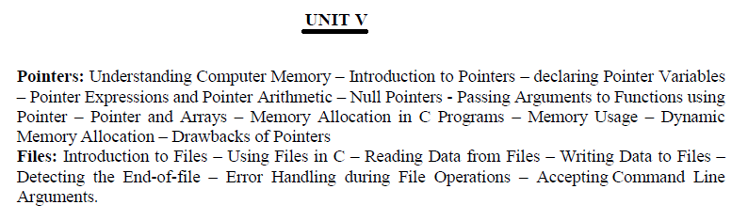

Slide 2
realloc() function
“realloc” or “re-allocation” method in C is used to dynamically change the memory allocation of a previously allocated memory. In other words, if the memory previously allocated with the help of malloc or calloc is insufficient, realloc can be used to dynamically re-allocate memory. re-allocation of memory maintains the already present value and new blocks will be initialized with default garbage value.

Slide 3
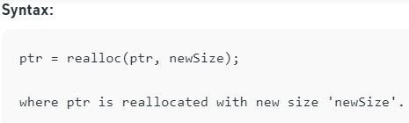
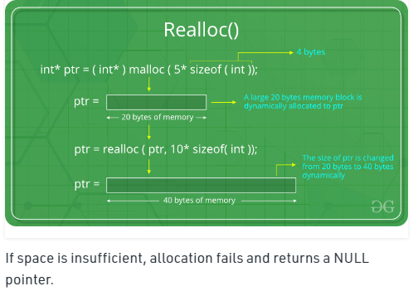

Slide 4
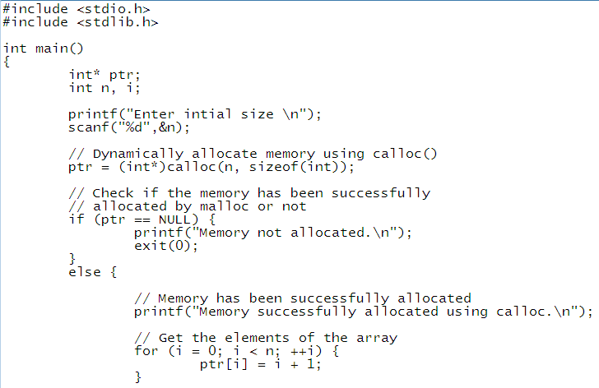

Slide 5
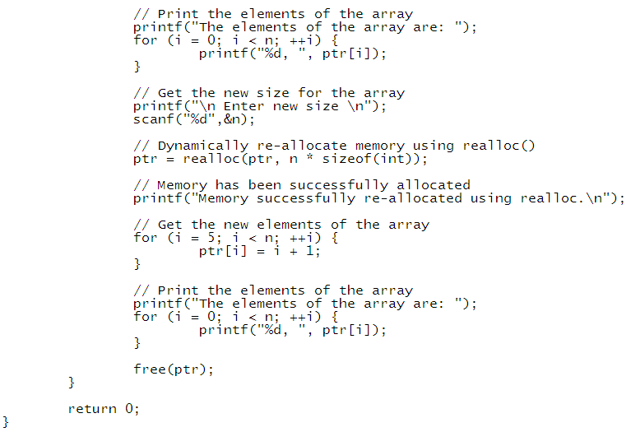

Slide 6
C free() function
“free” method in C is used to dynamically de-allocate the memory. The memory allocated using functions malloc() and calloc() is not de-allocated on their own. Hence the free() method is used, whenever the dynamic memory allocation takes place. It helps to reduce wastage of memory by freeing it.

Slide 7
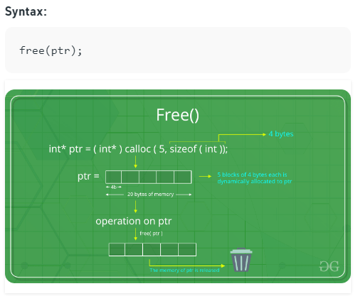

Slide 8
